Slide 1
CREDIT RATING PREDICTION
CONSTANTINE CONSTANTINIDIS

Slide 2
WHAT ARE CREDIT RATINGS ?
Quantified assessments of a borrower's creditworthiness
Qualify default probability brackets for a Borrower with respect to its debt obligations and its capability to service its existing debt obligations
Credit Ratings are calculated and published by Rating Agencies such as S&P, Moody’s, Fitch, AM Best, DBRS, etc.
Corporate Long Term Credit Ratings range from AAA to D (each agency uses similar tiering symbols)
Rating Agencies mainly use financial data (such as financial ratios) based on a company's balance sheet, cash flow and income statements, as well as macroeconomic data to determine the credit rating for each company and for each debt issuance.

Slide 3
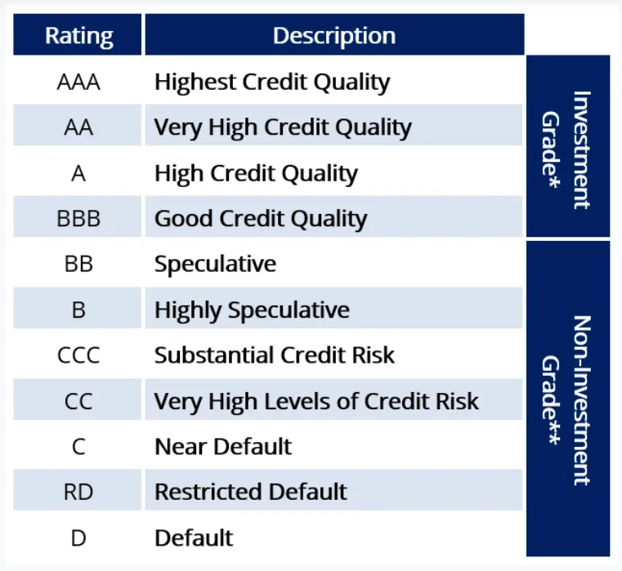
TYPES OF RATINGS
Bonds BBB and above are called Investment Grade and these Borrowers are expected to easily meet payment obligations.
They are the most sought after by banks, pension funds, insurance companies and institutional investors.
Bonds BB and below that are called Speculative Bonds also known as High Yield bonds or “Junk” bonds having the highest probability of default

Slide 4
PROPRIETARY RATING AGENCY MODELS
The methodology used by credit rating agencies and their models are highly proprietary.
The Financial Credit Crisis of 2008 caused tighter regulations for sharing with the public credit rating models (Dodd Frank Act)
In certain cases sharing credit rating models with the financial intermediaries and the public could be a criminal offense
Credit rating models have become black boxes !

Slide 5
MY PROPOSAL
Develop an appropriate machine learning algorithm to accurately predict the credit rating for long term senior corporate debt listed by US companies
Train model on publicly available credit ratings and financial stats obtained from S&P, Capital IQ and CRSP databases obtained from WRDS (Wharton Research Data Services)

Slide 6
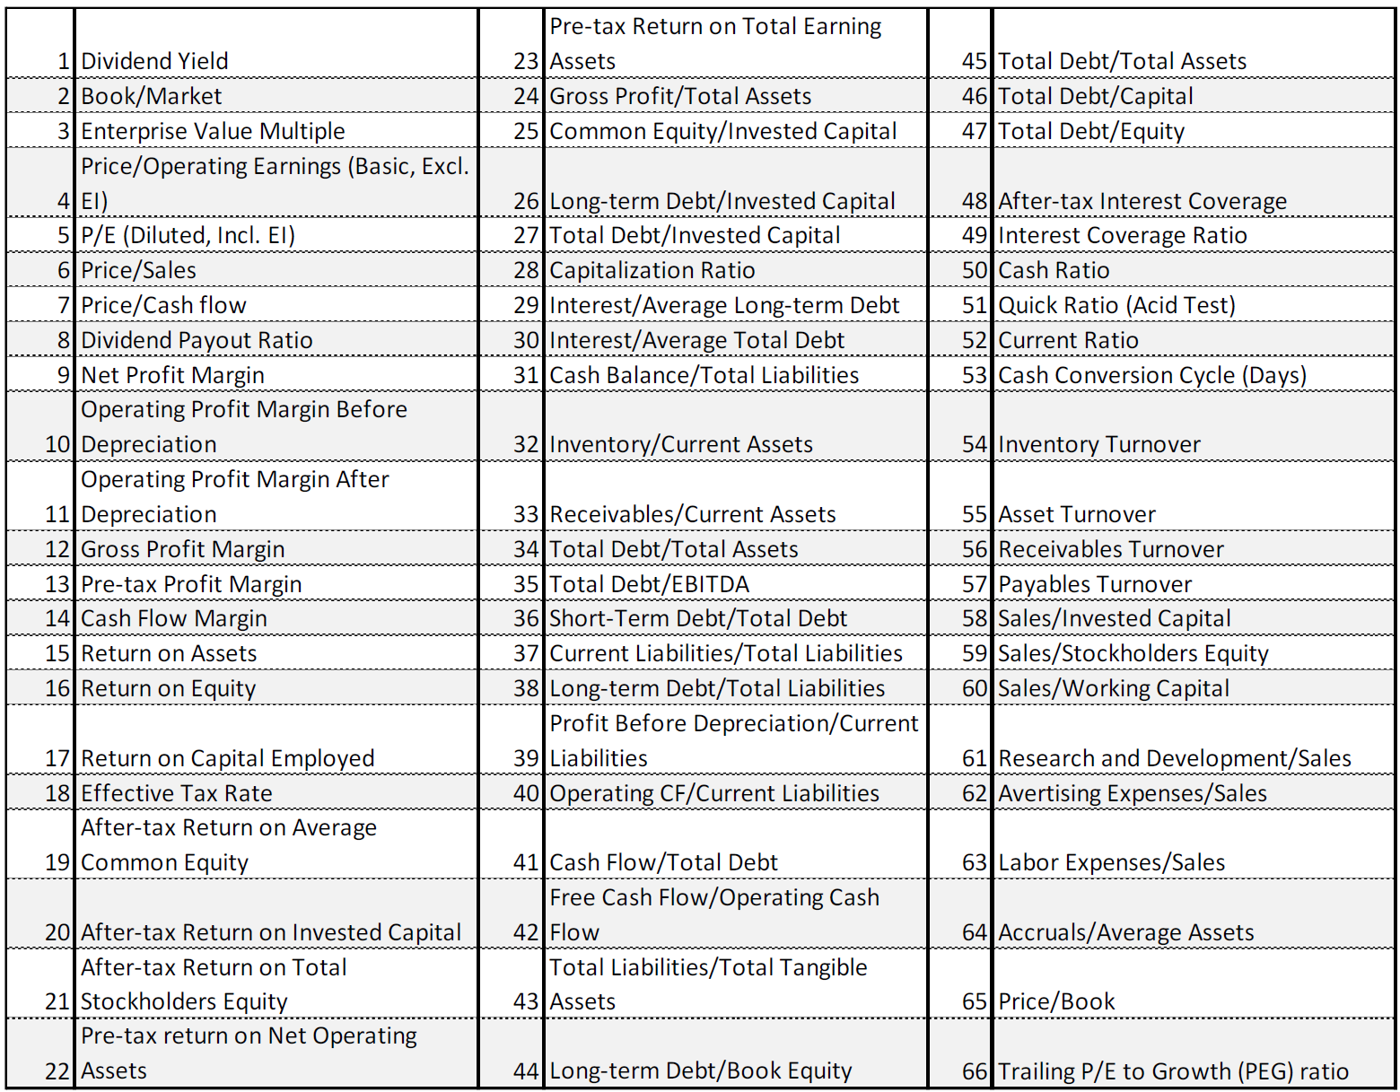
FIRST CHALLENGE : OBTAIN QUALITY DATA
Created database for S&P Long Term Credit Ratings for close to 6500 observations from 2017 to 2021 by using pandas library to cross reference three databases:
122,418 quarterly, semi, or annual S&P credit ratings of 8,635 US companies since 2017
480,738 monthly, quarterly, annual observations of 66 financial ratios for 7,103 US companies since 2017
1,048,575 company id vs cusip index database associating companies with debt issuances
We obtained 6,588 observations of rated company financial ratios but with significant gaps across various of the 66 ratios

Slide 7
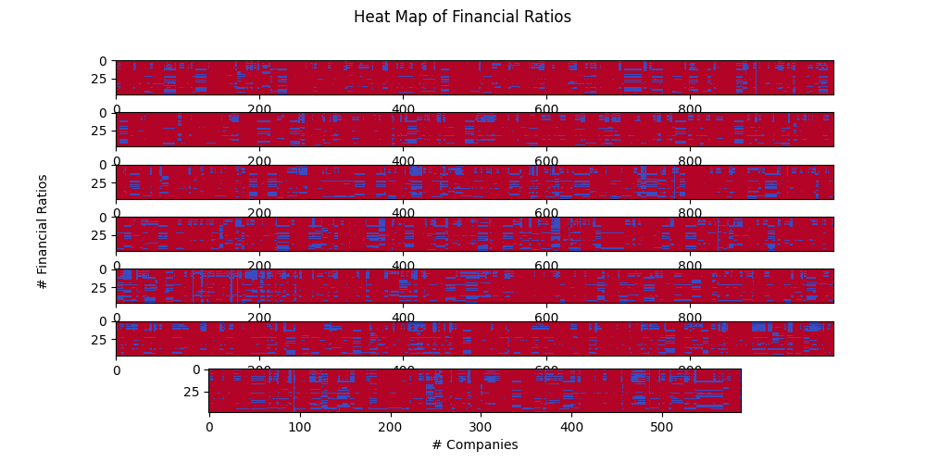
SOLVING DATA QUALITY PROBLEM
If we eliminated all financial ratio observations without full set of 66 ratio we would be left with only 855 observations

Slide 8
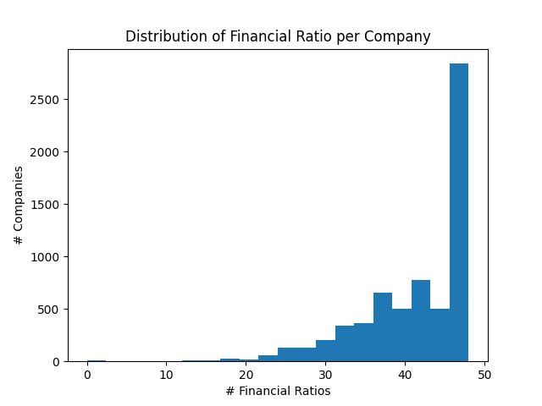
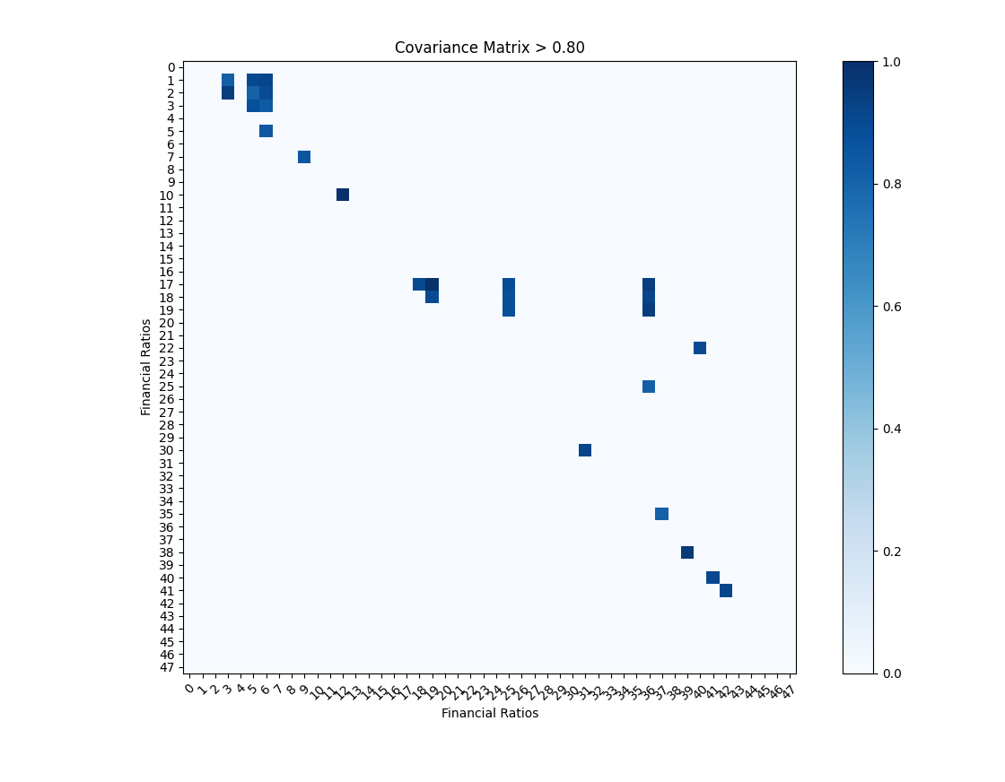
SOLVING DATA QUALITY PROBLEM
Many Financial Ratios are highly correlated between them enabling me to eliminate those that have the most non-zero non-NaN observations by setting the threshold at covariance > 0.80

Slide 9
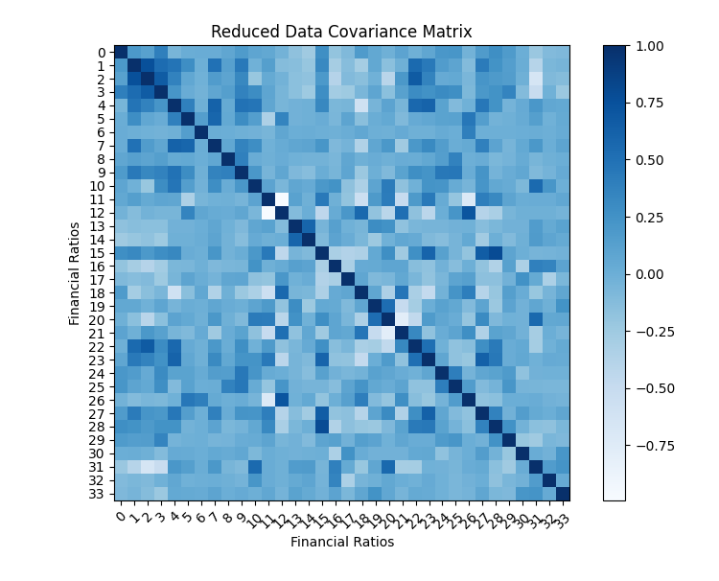
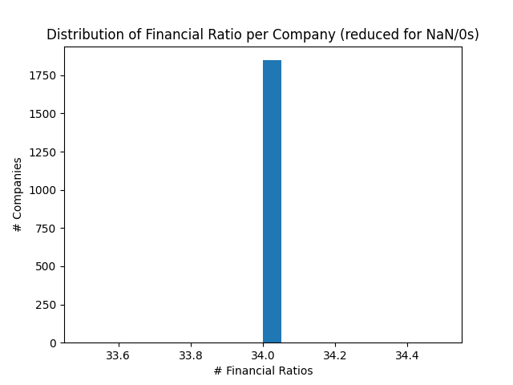
SOLVING DATA QUALITY PROBLEM
By eliminating those financial ratios from the database, I managed to obtain a set of 1,848 (from 6,587 orig) observations with a full 34 financial ratios each & less than 0.80 co-variance between them

Slide 10
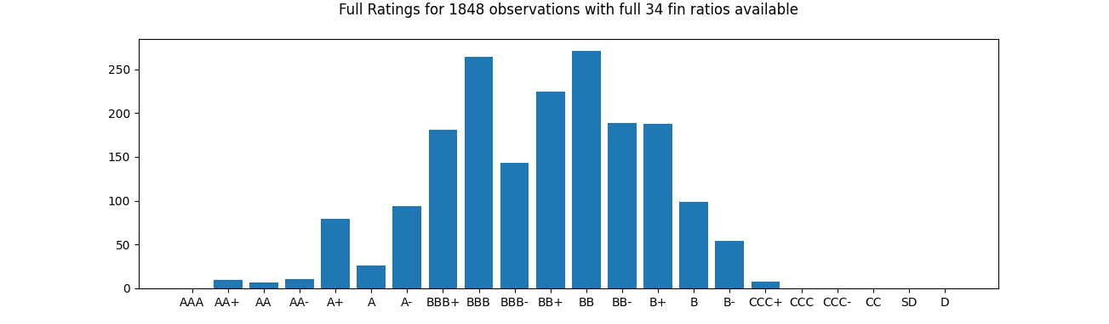
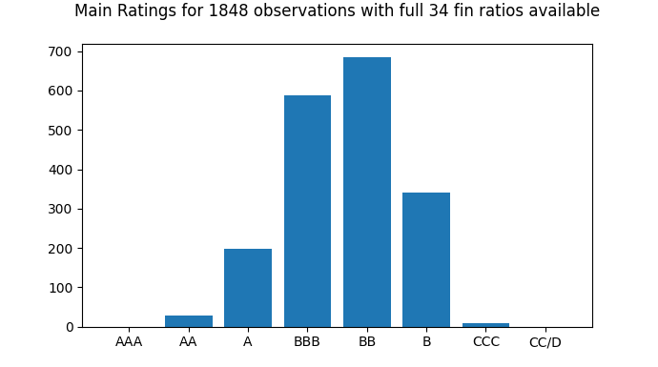
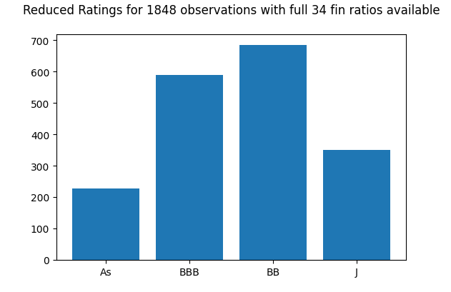
SOLVING DATA QUALITY PROBLEM
The credit rating distribution for the 1,848 observations have very few AAA/AAs and B/Cs compared to As, BBBs and BBs which may introduce bias to our learning algorithm. Need to reduce the classes to 2, 3, or 4 so each class has equal number of training data

Slide 11
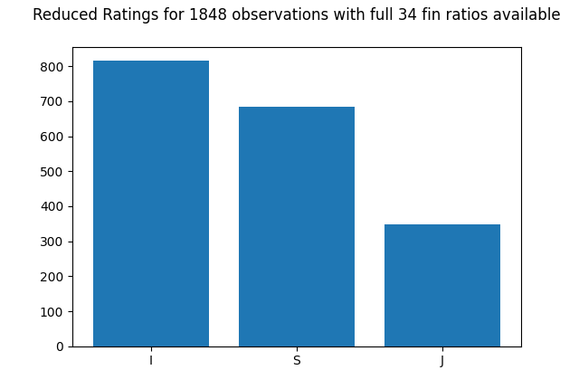
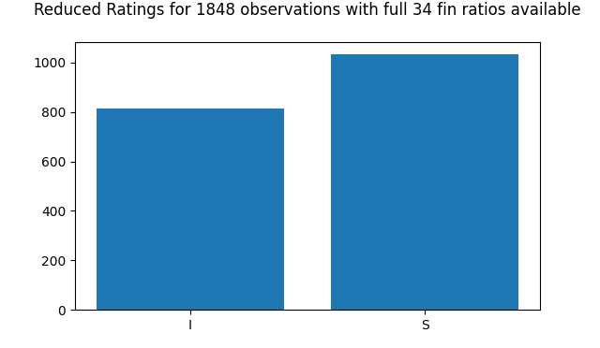
SOLVING DATA QUALITY PROBLEM
The market makes a large distinction between Investment Grade (AAA-BBB) and Speculative (BB-D). So this would be a natural place to start and if we can find more data then try to increase # classes

Slide 12
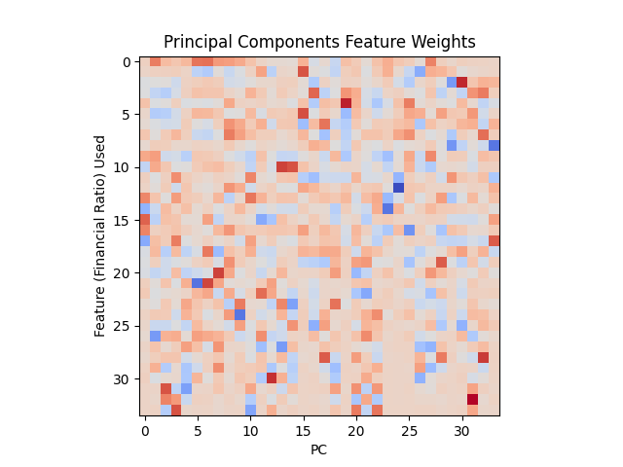
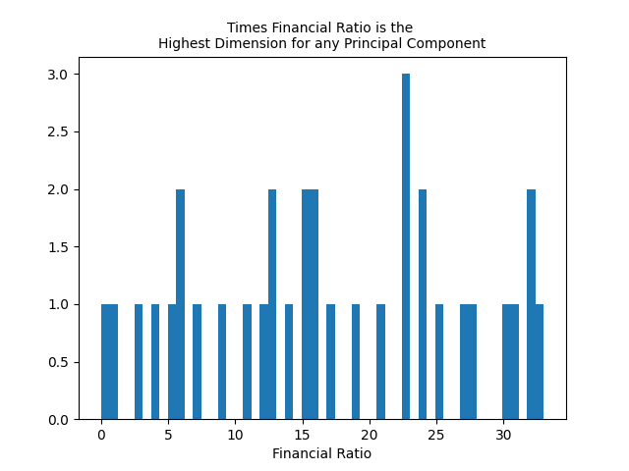
PRINCIPAL COMPONENT ANALYSIS
Applied PCA to the log(Financial Ratios) and centered them (around their mean). This gave much better results than PCA on just the centered just Financial Ratios

Slide 13
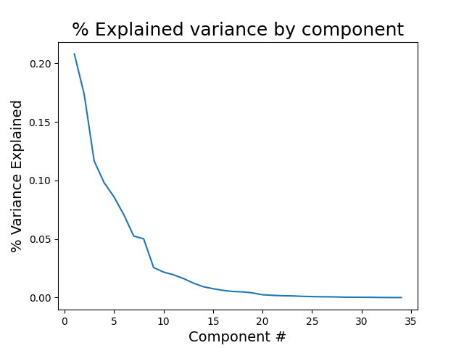
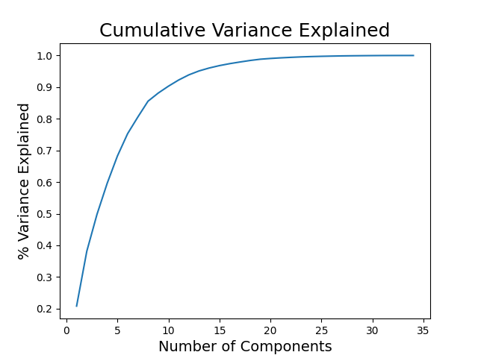
PRINCIPAL COMPONENT ANALYSIS
The 1st component explains 20.8% of variance, with 10 PCs 90% and 13 PCs 95%

Slide 14
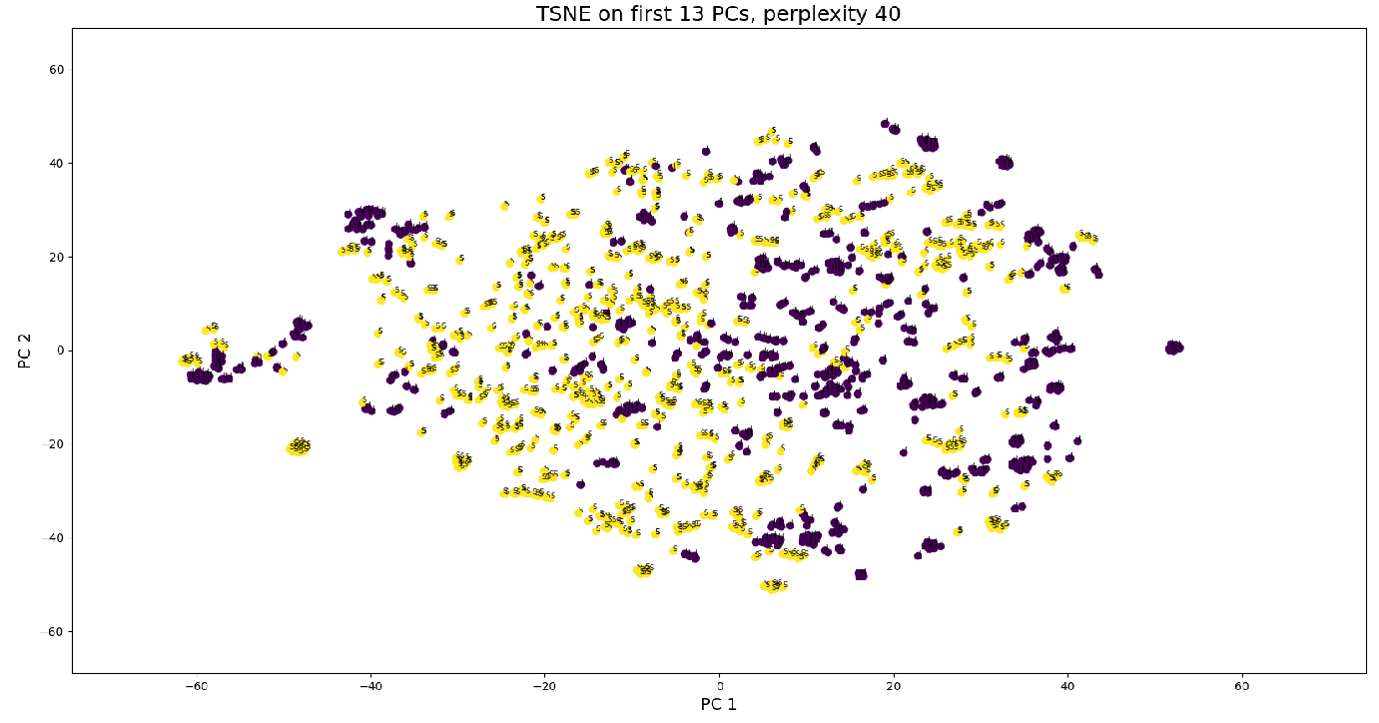
TSNE CLUSTERING
Used to visualize high-dimensional data (used the 13 PCs).
Converts similarities between data points to joint probabilities and tries to minimize the KL divergence
No apparent clusters seem to emerge across the PC1 vs PC2 dimensions

Slide 15
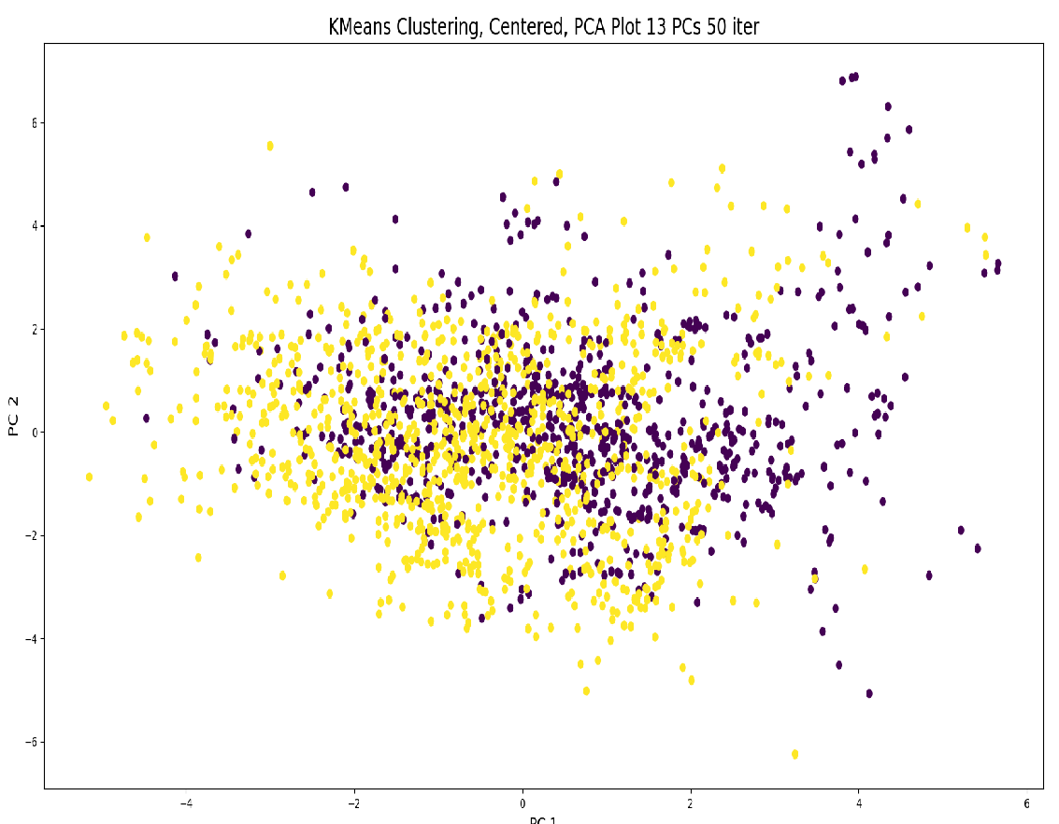
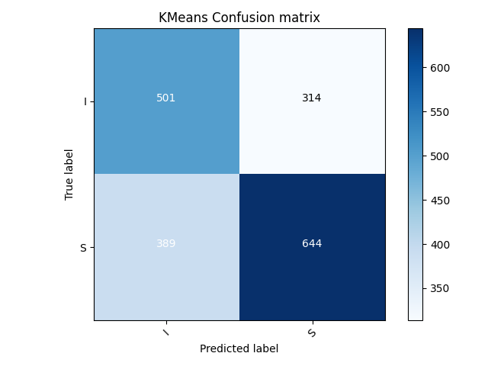
K-MEANS CLUSTERING
Another technique used to visualize high dimensional data which tries to separate samples in k groups of equal variance by minimizing a criterion known as the inertia.
No apparent clusters seem to emerge across the PC1 vs PC2 dimensions

Slide 16
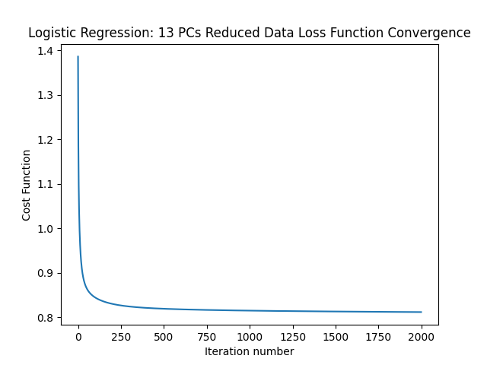
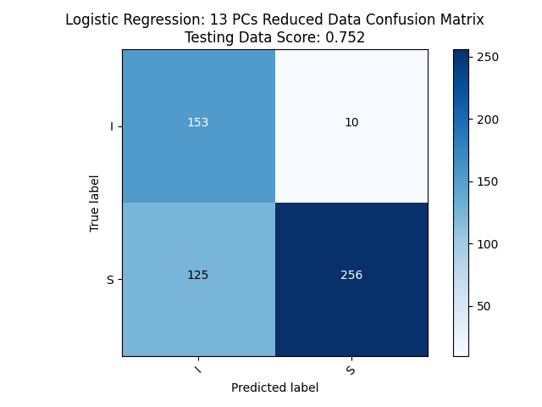
LOGISTIC REGRESSION
Applied Logistic Regression using a gradient descent algorithm to minimize the minimization of the multi-class cross-entropy with learning rate=0.2 and 2000 maximum iterations.
Got High Convergence with 0.752 Testing Score

Slide 17
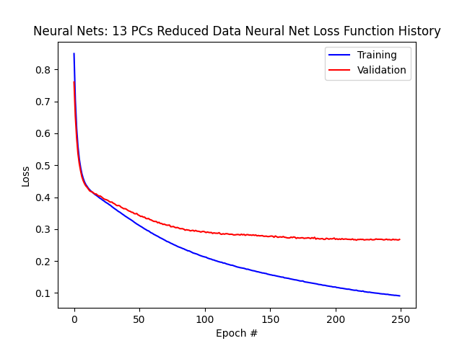
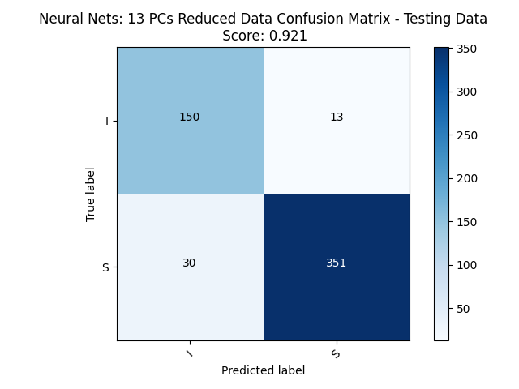
NEURAL NETS
After normalising the 13 PC adjusted centered data, applied a simple neural net with 1 hidden dense layer of 16 weights, tanh() activation function, and a softmax activation function for the output layer.
Used adam optimizer and run 250 epochs for batch size equal to 32
Got High Convergence with 0.92 for the Testing Score

Slide 18
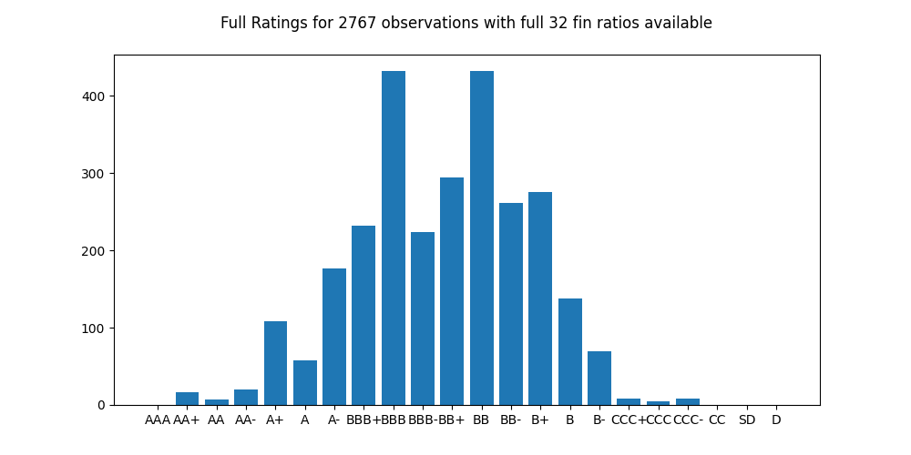
NEURAL NETS FOR 3 RATINGS CLASSES
By using a different mix of 32 financial ratios was able to increase observations to 2,760 and applied the NN to classifying 3 classes of credit ratings: I(Investment grade), S(Speculative/BB), J(Junk/B/CCC-D)

Slide 19
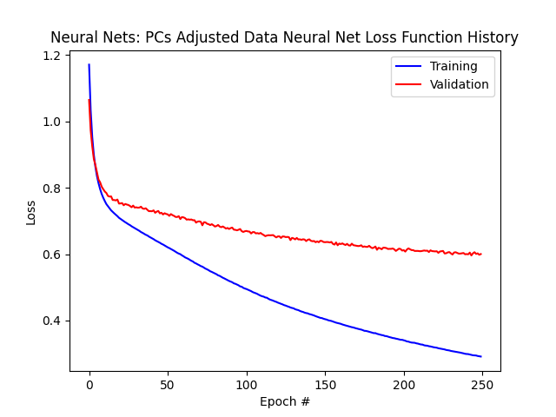
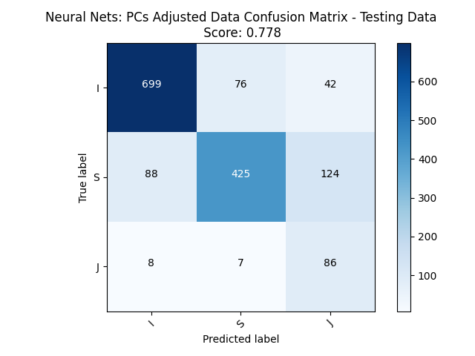
FOR 3 RATINGS CLASSES
Left model parameters unchanged and got 0.778 for the Testing Score for PCA adjusted data

Slide 20
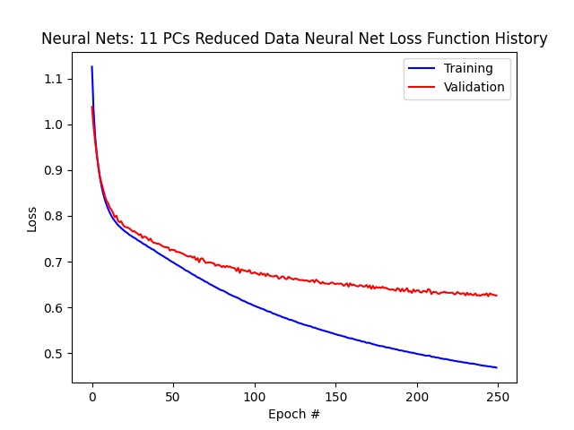
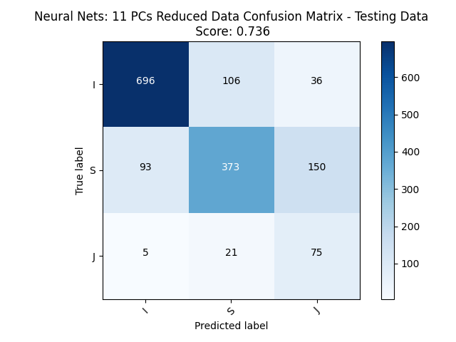
FOR 3 RATINGS CLASSES
Got 0.736 for the Testing Score if using only 11 PCs when adjusting the data

Slide 21
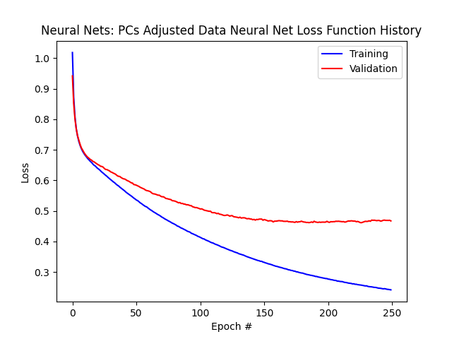
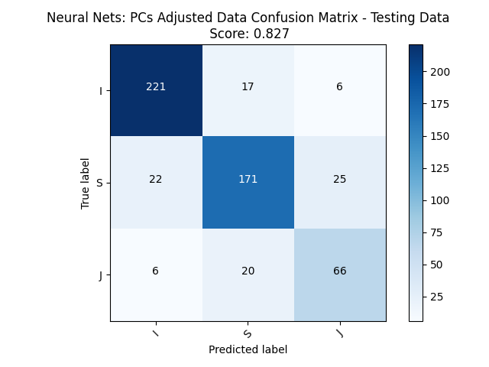
FOR 3 RATINGS CLASSES
Dropping the requirement to sample equal amounts of each label/class actually improves results. Shouldn’t introducing such bias reduce the prediction score for Junk class?
One answer could be that by not restricting the sampling a larger training set of 2,208 is possible vs. only 840 if all labels have to sampled equally

Slide 22
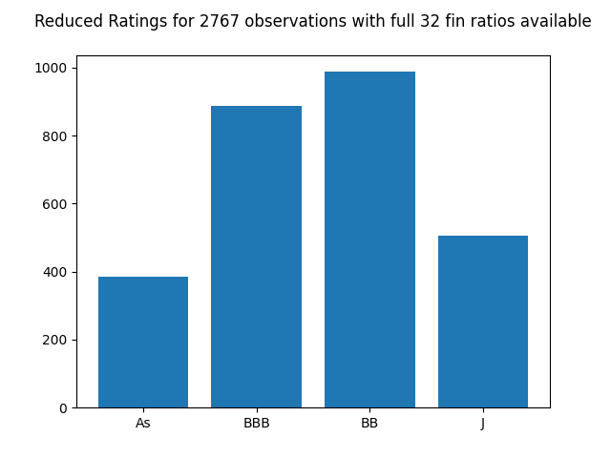
FOR 4 RATINGS CLASSES
Applied same to 4 credit rating classes As(AAA/AA/A), BBB, BB, J(unk/B/CCC-D)

Slide 23
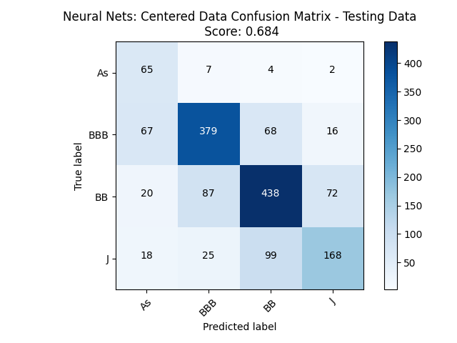
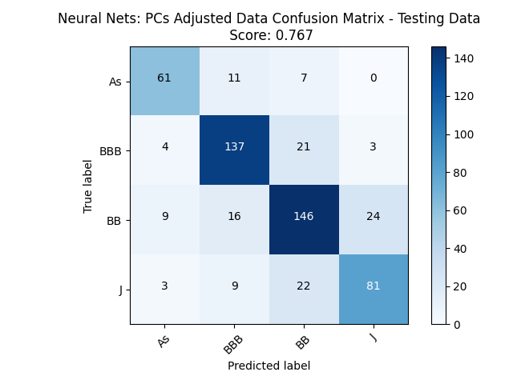
FOR 4 RATINGS CLASSES
Equal sampling of labels produced worst results (0.684 vs 0.767) than random uneven sampling of labels
Again the reason could be we are using only 1380 observations vs. 2208 in the uneven case for training

Slide 24
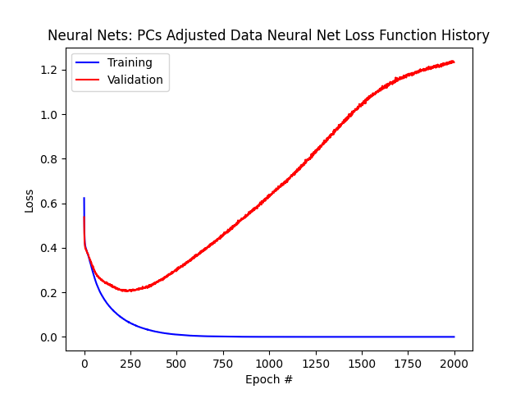
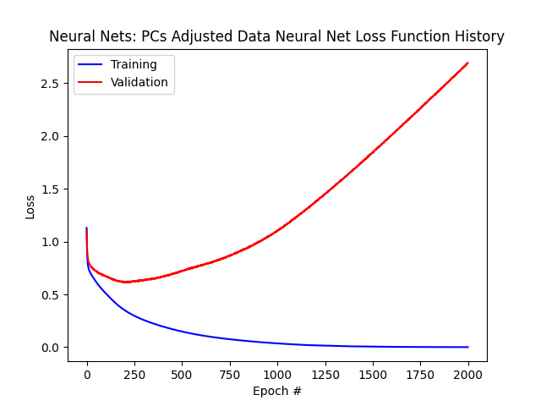
Increasing epochs for NN

Slide 25
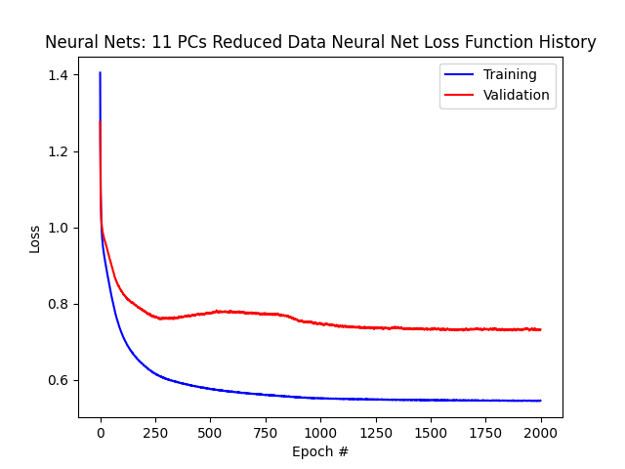
Reducing Principal Components removes overtraining

Slide 26
AREAS OF IMPROVEMENT
Data of Quality
More full data observations from previous years and more companies
COVID-19 related deterioration of financial ratios in 2019/2020 did not result in immediate credit ratings adjustments as Rating Agencies considered the effect to be temporary
Apply model to Moody’s, Fitch, AM Best, DBRS credit ratings as well
Test more complex neural networks (data availability permitting)
Increase classes to the full set of 23 sub-ratings categories (+/-)
Predict credit ratings changes and arbitrage opportunities to go long/short bonds prior to their ratings increase

